Slide 1
Lesson 9
Indexes

Slide 2
Introduction to Indexes
An index is a lookup structure created on a table to optimize sort and query performance
Indexes are created on a particular column(s), and store the data values for this column(s) in order
When table data is not stored in any particular order, it is referred to as a heap
The heap is composed of multiple pages, with each page containing multiple table rows

Slide 3
When raw underlying data is stored in order, sorted by a column(s) ,the situation is referred to as a clustered index
When searching for a particular value, the Query Optimizer can execute the query more efficiently by performing an index lookup rather than a table scan
Only one clustered index is allowed per table; usually this is created on the column designated as the PRIMARY KEY

Slide 4
Indexes
There are two basic types of indexes:
Clustered: is the actual table, the bottom level (leaf) of a clustered index contains the actual rows
Non Clustered: contains only the columns included in the index’s key, plus a pointer pointing to the actual data row
Tables that do not have a clustered index defined on them are called a heap

Slide 5
Clustered Indexes
Index restrictions:
You can define an index with a maximum of 16 columns
The maximum size of the index key is 900 bytes.

Slide 6
The column(s) defined for the clustered index are referred to as the clustering key
A clustered index causes SQL Server to arrange the data in the table according to the clustering key
Because a table cannot be sorted more than one way, you can define only one clustered index on a table

Slide 7
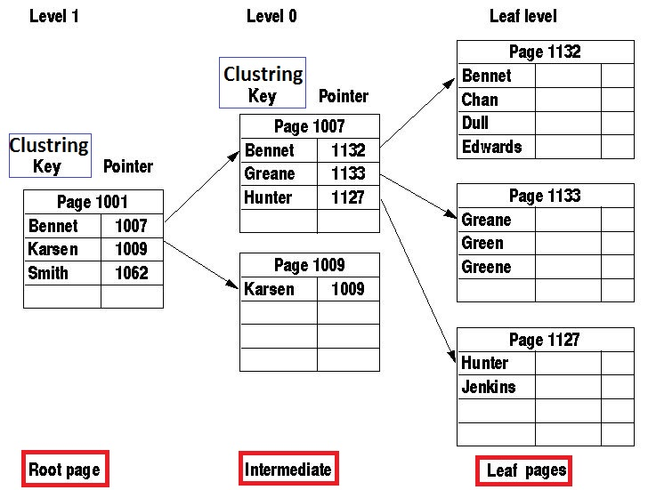
Clustered Index

Slide 8
Because the leaf level of a clustered index is the row of data in the table, when SQL Server traverses the clustered index down to the leaf level, it has retrieved the data. No additional reads are required to locate the required data.
Every table should have a clustered index. One of the main purposes of a clustered index is to eliminate forwarding pointers.

Slide 9
Nonclustered Indexes
Nonclustered indexes do not impose a sort order on the table, so you can create multiple nonclustered indexes on a table.
Nonclustered indexes have the same restrictions as a clustered index they can have a maximum of 900 bytes in the index key and a maximum of 16 columns.
A table is limited to a maximum of 999 nonclustered indexes.

Slide 10
The leaf level of a nonclustered index contains a pointer to the data you require
If a clustered index exists on the table, the leaf level of the nonclustered index points at the clustering key
If a clustered index does not exist on the table, the leaf level of the nonclustered index points at the row of data in the table

Slide 11
Creating Index
It makes sense to create nonclustered indexes on all frequently searched fields in a table.
The trade-off with indexes is write performance.
Every time a new row is inserted, the index must also be updated.

Slide 12
CREATE [ UNIQUE ] [ CLUSTERED | NONCLUSTERED ] INDEX index_name
ON <object> ( column [ ASC | DESC ] [ ,...n ] )
[ INCLUDE ( column_name [ ,...n ] ) ]
[ WHERE <filter_predicate> ]
[ WITH ( <relational_index_option> [ ,...n ] ) ]
<object> ::=
{ [ database_name. [ schema_name ] . | schema_name. ]
table_or_view_name
}
<relational_index_option> ::=
{ PAD_INDEX = { ON | OFF }
| FILLFACTOR = fillfactor
| SORT_IN_TEMPDB = { ON | OFF }
| IGNORE_DUP_KEY = { ON | OFF }
| STATISTICS_NORECOMPUTE = { ON | OFF }
| DROP_EXISTING = { ON | OFF }
| ONLINE = { ON | OFF }
| DATA_COMPRESSION = { NONE | ROW | PAGE}
}

Slide 13
UNIQUE: No two rows are permitted to have the same index key value
A clustered index on a view must be unique
CLUSTERED: Creates an index in which the logical order of the key values determines the physical order of the corresponding rows in a table. Max 16 cols. Max size 900 bytes
Existing non-clustered indexes on tables are rebuilt when a clustered index is created

Slide 14
NONCLUSTERED: (default) Each table can have up to 999 non-clustered indexes
Column: Is the column or columns on which the index is based
List the columns to be used as key, in sort-priority order
Max 16 columns can be combined into a single composite index key.
The maximum allowable size of the combined index values is 900 bytes.

Slide 15
INCLUDE: Specifies the non-key columns to be added to the leaf level of the non-clustered index max 1023.
The non-clustered index can be unique or non-unique.
Column names cannot be repeated in the INCLUDE list and cannot be used simultaneously as both key and non-key columns.
Non-clustered indexes always contain the clustered index columns if a clustered index is defined on the table

Slide 16
WHERE: Creates a filtered index by specifying which rows to include in the index.
The filtered index must be a non-clustered index on a table.
Creates filtered statistics for the data rows in the filtered index.
FILLFACTOR: Specifies a percentage indicating how full the leaf level of each index page during index creation or rebuild would be. A fill factor of 80 means 20% of each page will be empty when creating or rebuilding

Slide 17
PAD_INDEX = ON | OFF Specifies index padding.
The default is OFF.
ON: The percentage of free space that is specified by FILLFACTOR is applied to the intermediate-level and root pages of the index.
OFF: The intermediate-level pages are filled to near capacity, leaving sufficient space for at least one row

Slide 18
SORT_IN_TEMPDB = ON | OFF
Specifies whether the data should be sorted in the tempdb database instead of the current database. This may give performance advantages if the tempdb database is stored on a different disk to the current database
IGNORE_DUP_KEY = ON | OFF
Allows any rows to be inserted that do not produce duplicate values and reject only the rows that cause duplicates in a multi-row insert operation

Slide 19
DROP_EXISTING = ON | OFF
Specifies that the existing index with the same name should be dropped and then be re-created. This equates to an index rebuild.
ONLINE = ON | OFF
Specifies whether underlying tables and indexes are available for queries and data modification during the index operation.
DATA_COMPRESSION = NONE | ROW | PAGE
Use data compression at row or page level of the index

Slide 20
--Create the table specifying that the primary key
--index is to be created as nonclustered
CREATE TABLE Stars
(StarID int PRIMARY KEY NONCLUSTERED,
StarName varchar(50) Unique,
SolarMass decimal(10,2) CHECK(SolarMass > 0),
StarType varchar(50) DEFAULT 'Orange Giant');
GO
CREATE CLUSTERED INDEX Ix_Star_Name
ON Stars(StarName)
WITH (PAD_INDEX = ON,
FILLFACTOR = 70,
ONLINE = ON);
GO
CREATE NONCLUSTERED INDEX Ix_Star_Type
ON Stars(StarType)
WITH (PAD_INDEX = ON,
FILLFACTOR = 90);
GO

Slide 21
Index Architecture
The structure that SQL Server uses to build and maintain indexes is called a balanced tree (B-tree)
A B-tree is constructed of a root node that contains a single page of data, one or more optional intermediate level pages, and one or more optional leaf level pages.
A B-tree is always symmetrical, with the same number of pages on both the left and right halves at each level.

Slide 22
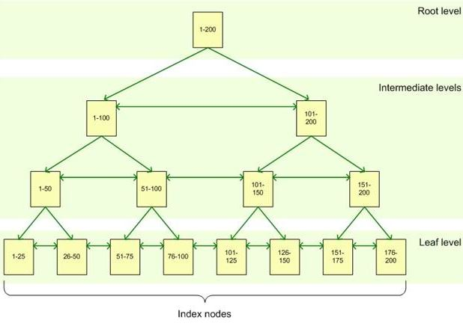
Balanced Tree

Slide 23
The number of index rows on a page is determined by the storage space required by the columns that are defined in the index.
Pages in SQL Server can store up to 8,060 bytes of data. So an index created on a column with an INT data type (4 Byte) can store 2,015 values on a single page within the index

Slide 24
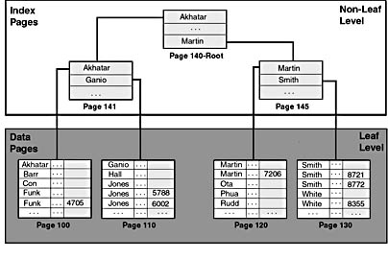
The root and intermediate levels of the index are constructed by taking the first entry from every page in the level below, along with a pointer to the page where the data value came from

Slide 25
Covered Indexes
In a covered index there is no need to use lookups between the non-clustered index and the table to return the query results
The performance gained by using a covered index is great for queries that return a large number of rows (a nonselective query) and smaller for queries that return few rows (a selective query)

Slide 26
TABLE A
Col1 | Col2 | Col3
SELECT Col1 FROM Test.TableA WHERE Col2 = 1;
CREATE NONCLUSTERED INDEX TestIndex ON Test.TableA (Col1, Col2);
CREATE NONCLUSTERED INDEX TestIndex ON Test.TableA (Col2, Col1);
CREATE NONCLUSTERED INDEX TestIndex ON Test.TableA (Col1) INCLUDE (Col2);
CREATE NONCLUSTERED INDEX TestIndex ON Test.TableA (Col2) INCLUDE (Col1);
CREATE NONCLUSTERED INDEX TestIndex ON Test.TableA (Col1, Col2, Col3);
CREATE NONCLUSTERED INDEX TestIndex ON Test.TableA (Col3) INCLUDE (Col1, Col2);
These are all covered indexes for above query

Slide 27
A covered index always performs better than a non-covered index
For queries that return a very limited number of rows, a non-covered index also performs very well.

Slide 28
Included Columns
Included columns cannot be used for tasks such as filtering or sorting;
Their benefit is reducing page reads through covering queries by avoiding table lookups;
Only columns that are used for filtering, grouping, or sorting should be part of the index key;
An index can have a maximum of 1,023 included columns;

Slide 29
CREATE TABLE dbo.IncludedColumnsTest(
PKCol UNIQUEIDENTIFIER NOT NULL
DEFAULT NEWSEQUENTIALID()
PRIMARY KEY CLUSTERED
,Col1 INT IDENTITY NOT NULL
,Col2 CHAR (20) NOT NULL
,Col3 CHAR (20) NOT NULL
,Col4 CHAR (20) NOT NULL
,Col5 CHAR (20) NOT NULL
,Col6 CHAR (20) NOT NULL
,Col7 CHAR (20) NOT NULL
,Col8 CHAR (20) NOT NULL
,Col9 CHAR (20) NOT NULL
,Col10 CHAR (20) NOT NULL
,Col11 CHAR (20) NOT NULL
,Col12 CHAR (20) NOT NULL
,Col13 CHAR (20) NOT NULL
,Col14 CHAR (20) NOT NULL
,Col15 CHAR (20) NOT NULL
,Col16 CHAR (20) NOT NULL
);

Slide 30
INSERT dbo.IncludedColumnsTest (Col2, Col3, Col4, Col5,
Col6, Col7, Col8, Col9, Col10, Col11, Col12, Col13,
Col14, Col15, Col16)
SELECT TOP(1000000)
CAST (message_id AS CHAR(20)) AS Col2
,CAST (message_id AS CHAR(20)) AS Col3
,CAST (message_id AS CHAR(20)) AS Col4
,CAST (message_id AS CHAR(20)) AS Col5
,CAST (message_id AS CHAR(20)) AS Col6
,CAST (message_id AS CHAR(20)) AS Col7
,CAST (message_id AS CHAR(20)) AS Col8
,CAST (message_id AS CHAR(20)) AS Col9
,CAST (message_id AS CHAR(20)) AS Col10
,CAST (message_id AS CHAR(20)) AS Col11
,CAST (message_id AS CHAR(20)) AS Col12
,CAST (message_id AS CHAR(20)) AS Col13
,CAST (message_id AS CHAR(20)) AS Col14
,CAST (message_id AS CHAR(20)) AS Col15
,CAST (message_id AS CHAR(20)) AS Col16
FROM sys.messages AS sm
CROSS JOIN (
SELECT TOP(15) 1 AS Col FROM sys.messages
) AS x;
Populating the table with 1,000,000 rows

Slide 31
CREATE NONCLUSTERED INDEX IncludedColumns ON dbo.IncludedColumnsTest (Col1)
INCLUDE (Col2, Col3, Col4, Col5, Col6, Col7, Col8,
Col9, Col10, Col11, Col12, Col13, Col14,
Col15, Col16);
CREATE NONCLUSTERED INDEX NoIncludedColumns ON dbo.IncludedColumnsTest
(Col1, Col2, Col3, Col4, Col5, Col6, Col7, Col8,
Col9, Col10, Col11,Col12, Col13, Col14, Col15,
Col16);
16 column wide index key
You can retrieve information about index from the sys.dm_db_index_physical_stats dynamic management function :
SELECT * FROM sys.dm_db_index_physical_stats(
DB_ID(),OBJECT_ID('IncludedColumnsTest'),
NULL, NULL, 'DETAILED'
)

Slide 32
In a table with 1,000,000 rows
 | INCLUDED COLUMN | NOINCLUDED COLUMN
Total size | 40,147 pages | 41,743 pages
Size of the nonleaf level of the index | 146 pages | 1,743 pages
Index depth | Three levels (a root page + one intermediate level + one leaf level) | Five levels (a root page + three intermediate levels + one leaf level)
Average size of rows in the nonleaf levels of the index | 27 bytes | 327 bytes
Average size of rows in the leaf level of the index | 321 bytes | 321 bytes

Slide 33
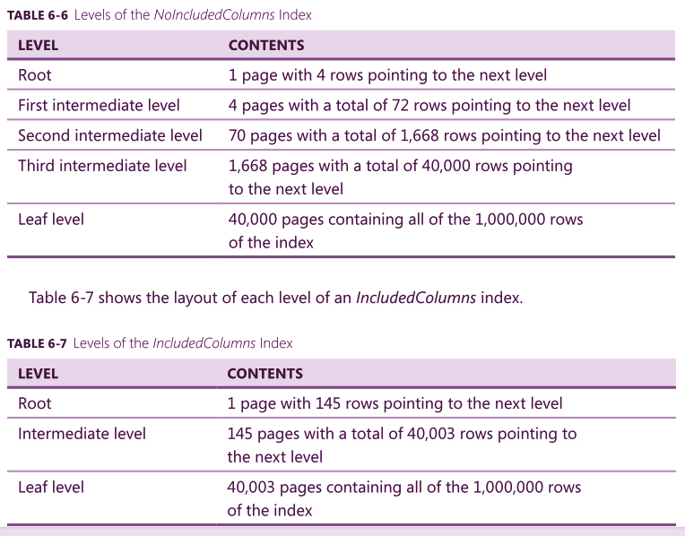
Rows are larger therefore less rows per page

Slide 34
additional objects and indexes required by the example:
-- Create the NotCovered index.
CREATE NONCLUSTERED INDEX NotCovered ON dbo.IncludedColumnsTest (Col1);
-- Create and populate the Test.OtherTable table.
CREATE TABLE dbo.OtherTable (
PKCol INT IDENTITY NOT NULL PRIMARY KEY
,Col1 INT NOT NULL
);
INSERT dbo.OtherTable (Col1)
SELECT Col1 FROM dbo.IncludedColumnsTest;

Slide 35
QUERY | PAGE READS
SELECT o.PKCol, i.Col2 FROM dbo.OtherTable AS o INNER JOIN dbo.IncludedColumnsTest AS i WITH(INDEX(IncludedColumns)) ON o.Col1 = i.Col1 WHERE o.PKCol BETWEEN 1 AND 10000; | 32,726 pages
SELECT o.PKCol, i.Col2 FROM dbo.OtherTable AS o INNER JOIN dbo.IncludedColumnsTest AS i WITH(INDEX(NoIncludedColumns)) ON o.Col1 = i.Col1 WHERE o.PKCol BETWEEN 1 AND 10000; | 53,994 pages
SELECT o.PKCol, i.Col2 FROM dbo.OtherTable AS o INNER JOIN dbo.IncludedColumnsTest AS i WITH(INDEX(NotCovered)) ON o.Col1 = i.Col1 WHERE o.PKCol BETWEEN 1 AND 10000; | 62,900 pages
Index hints WITH is used to force SQL Server to use the specified index instead of the optimal index (IncludedColumns )

Slide 36
Using Clustered Indexes
A clustered index should generally be defined on columns that are often queried and typically return a lot of data
Key size of the clustered index should be as small as possible
If a clustered index exists on a table, all nonclustered indexes on that table use the key of the clustered index as the row pointer from the nonclustered index to the table

Slide 37
Read vs. Write Performance
Indexes only increase the read performance.
Write performance is degraded because the indexes must be kept up-to-date

Slide 38
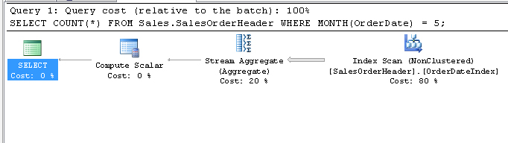
Computed Columns
Index on computed columns can increase query performance
SELECT COUNT(*) FROM Sales.SalesOrderHeader
WHERE MONTH(OrderDate) = 5;
Use of function
SCAN

Slide 39
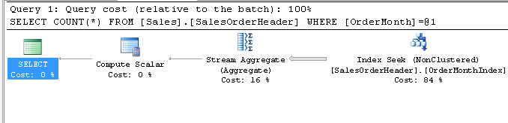
--Adding a computed column and nonclustered index
ALTER TABLE Sales.SalesOrderHeader
ADD OrderMonth AS MONTH(OrderDate);
GO
CREATE NONCLUSTERED INDEX OrderMonthIndex
ON Sales.SalesOrderHeader (OrderMonth);
GO
SELECT
COUNT(*) FROM Sales.SalesOrderHeader
WHERE MONTH(OrderDate) = 5;
SEEK

Slide 40
Indexed Views
Requirements for indexing views:
The view must not reference any other views, only base tables
All base tables referenced by the view must be in the same database as the view and have the same owner as the view
The view and UDFs used within it must be created with the SCHEMABINDING
All Functions referenced by expressions in the view must be deterministic

Slide 41
The optimizer can automatically detect and use an indexed view that satisfies a certain query, even if the indexed view is not referenced in the query.

Slide 42
Defragmenting an Index
You defragment an index by using the ALTER INDEX statement
ALTER INDEX { index_name | ALL }
ON <object>
{ REBUILD
[ [ WITH ( <rebuild_index_option> [ ,...n ] ) ]
| [ PARTITION = partition_number
[ WITH ( <single_partition_rebuild_index_option>
[ ,...n ] )] ] ]
| DISABLE | REORGANIZE
[ PARTITION = partition_number ]
[ WITH ( LOB_COMPACTION = { ON | OFF } ) ]
| SET ( <set_index_option> [ ,...n ] ) }[ ; ]

Slide 43
You defragment an index using either the REBUILD or REORGANIZE options
The REBUILD option rebuilds all levels of the index and leaves all pages filled according to the FILLFACTOR setting of an index
If you rebuild the clustered index, only the clustered index is rebuilt
Rebuilding the clustered index with the ALL keyword also rebuilds all non-clustered indexes on the table

Slide 44
The REORGANIZE option removes fragmentation only at the leaf level
Intermediate-level pages and the root page are not defragmented during a reorganize
REORGANIZE is always an online operation that does not incur any long-term blocking

Slide 45
Disabling an index
An index can be disabled by using the ALTER INDEX statement as follows:
If a clustered index is disabled, the entire table becomes inaccessible.
ALTER INDEX { index_name | ALL }
ON <object>
DISABLE [ ; ]

Slide 46
To enable an index, it must be rebuilt to regenerate and populate the B-tree structure.
ALTER INDEX { index_name | ALL }
ON <object>
REBUILD [ ; ]

Slide 47
Analyzing Index Usage
You can query the sys.dm_db_index_usage_stats dynamic management view (DMV) to find index-usage information
All values in the sys.dm_db_index_usage_stats view are reset whenever the SQL Server service is restarted.

Slide 48
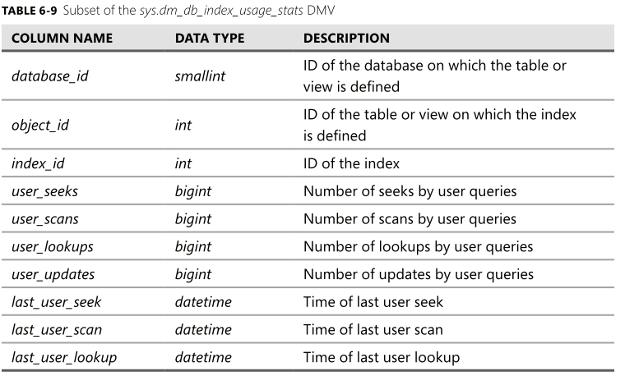

Slide 49
Tuning Indexes Automatically
An aggregation of missing indexes that the optimizer has needed can be found in the sys.dm_db_missing_index_details, sys.dm_db_missing_index_groups, and sys.dm_db_missing_index_group_stats database management views (DMVs).
You can also use the Database Engine Tuning Advisor graphical utility to retrieve information on indexes, indexed views, and even partitioning solutions that may help query performance

Slide 50
Find the 10 missing indexes with the highest anticipated improvement for user queries
SELECT TOP 10 * FROM sys.dm_db_missing_index_group_stats
ORDER BY avg_total_user_cost * avg_user_impact * (user_seeks + user_scans) DESC;

